Slide 1



Optimizing School Engagement, Equity, and Program Accessibility at KID Museum Using Data-Driven Insights
Piushani Ellegala
DATA 205

Slide 2
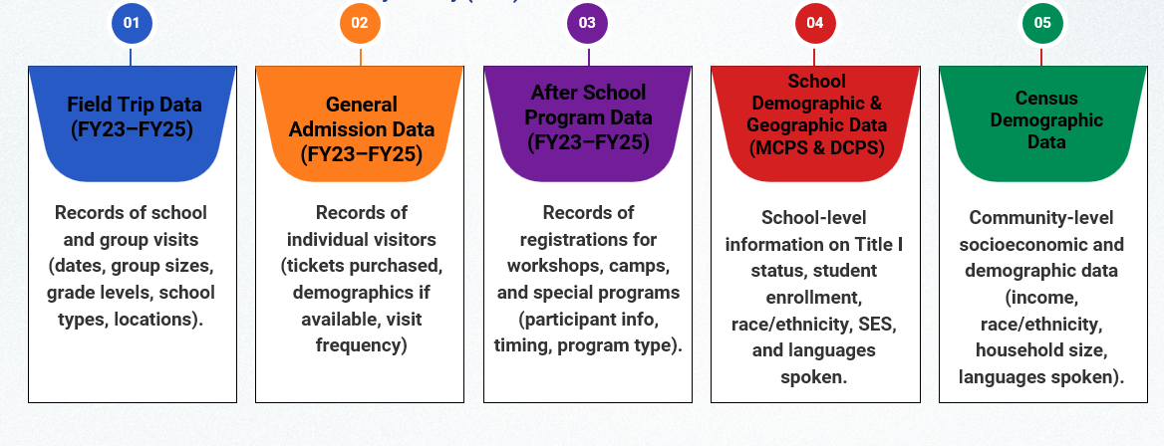
DATA

Slide 3
DATA WRANGLING AND INTEGRATION
Merged MCPS + DCPS datasets into a unified school table using ID and school name.
Cleaned missing ZIP codes, standardized address and date formats, and corrected naming inconsistencies.
Created derived Boolean columns:
eg: Underserved → Title I or CEP or FARMs > 40 %
Underrepresented → (Black % + Hispanic %) ≥ 30 %
Geocoded school and museum sites for ArcGIS and Folium mapping.
Linked demographic tables with Field Trip, After-School, and Admissions data to connect engagement patterns, demographics, and distance zones.
Integrated Census variables for socioeconomic mapping and forecasting.

Slide 4
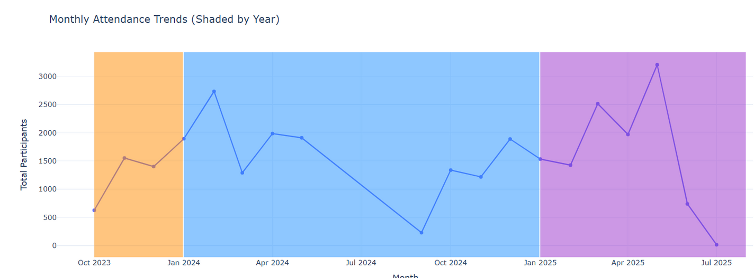
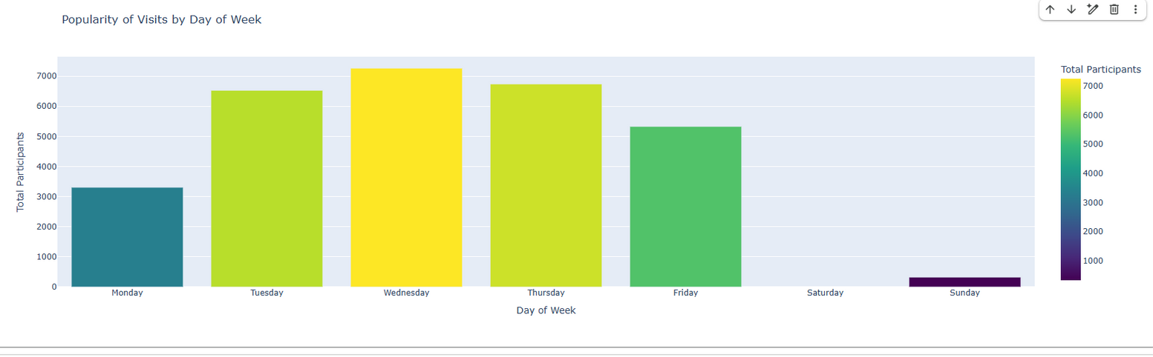
EXPLORATORY DATA ANALYSIS
Temporal Analysis of Field Trip Attendance by Month
Weekly Distribution of General Admissions Attendance

Slide 5
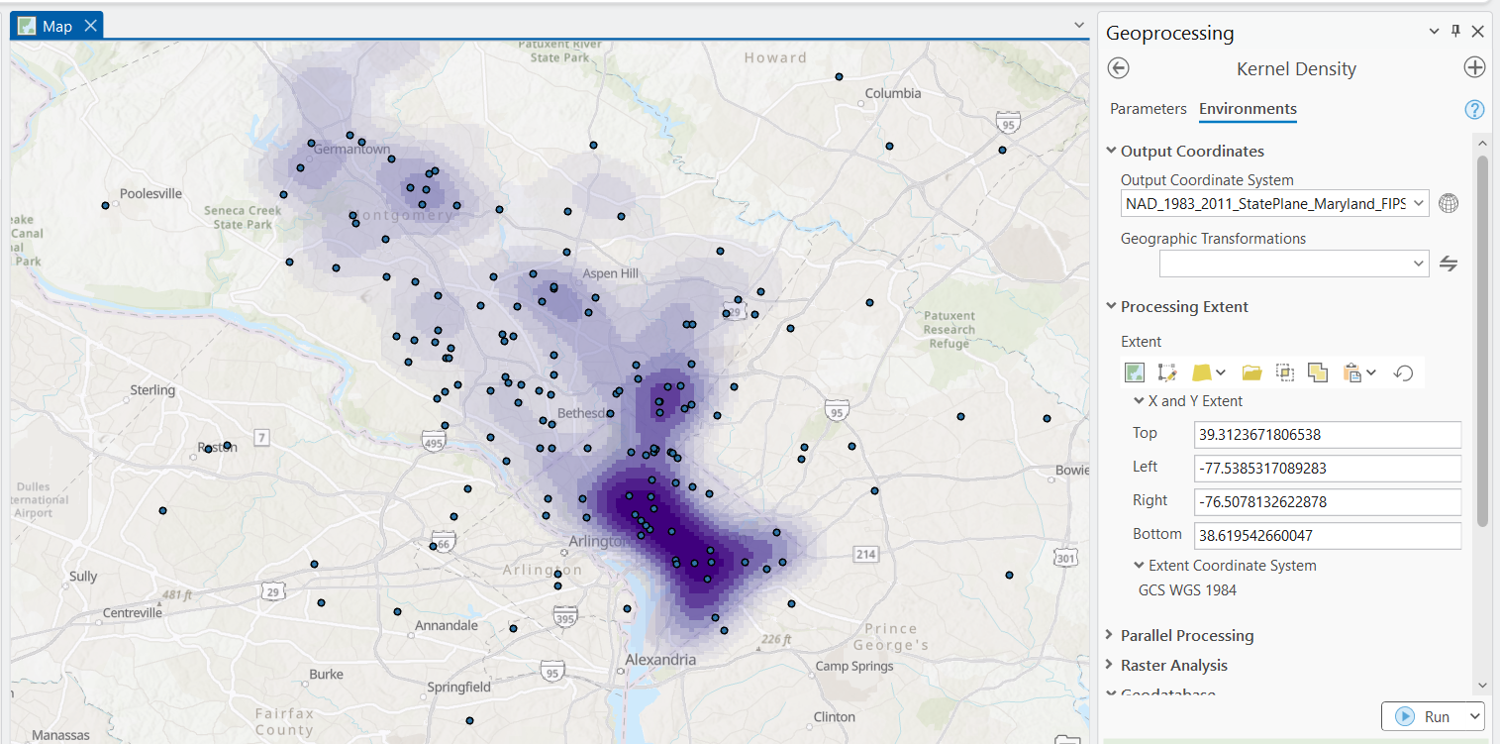
EXPLORATORY DATA ANALYSIS
Spatial Distribution of Underserved Schools in the KID Museum Service Area
ArcGIS Example

Slide 6
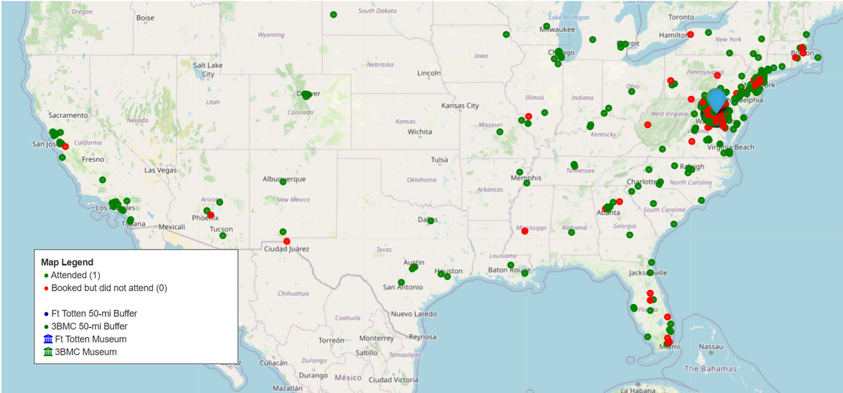
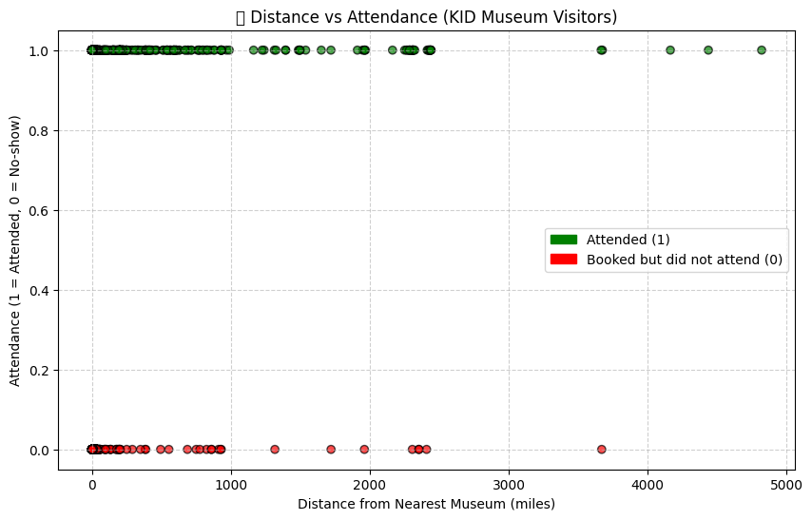
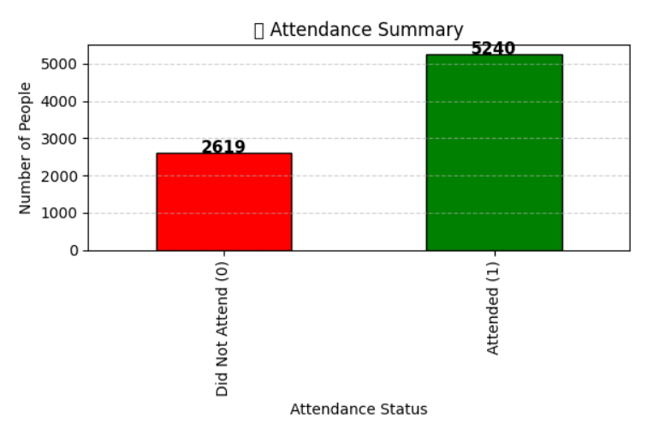
EXPLORATORY DATA ANALYSIS
How Distance Influences Engagement with KID Museum Programs
Schools closer to museum sites show higher attendance rates, while those farther away are more likely to cancel or not attend, suggesting that distance and transportation access are key factors in participation.

Slide 7
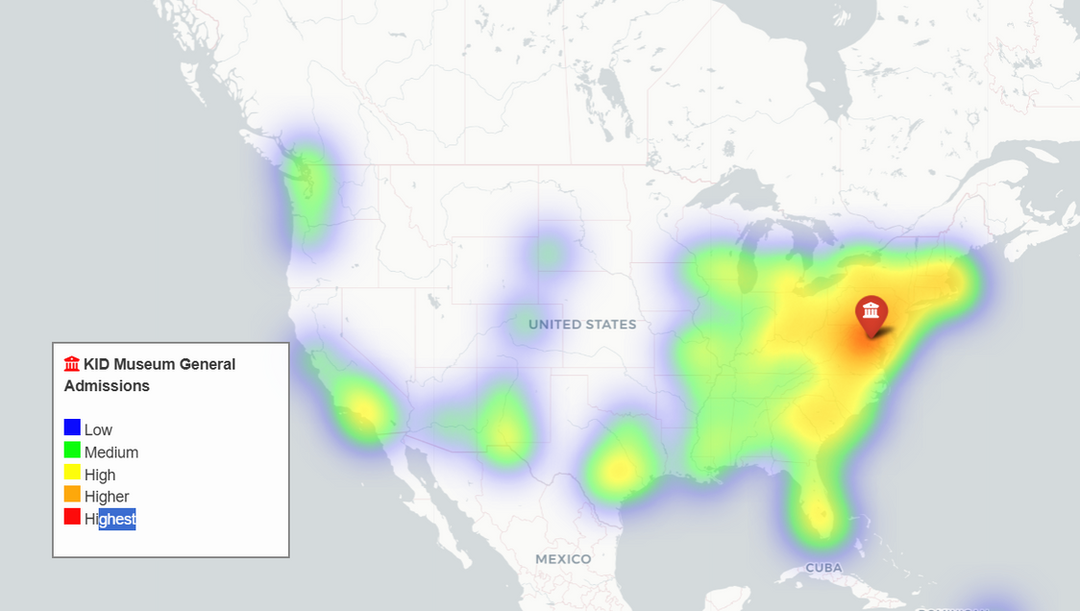
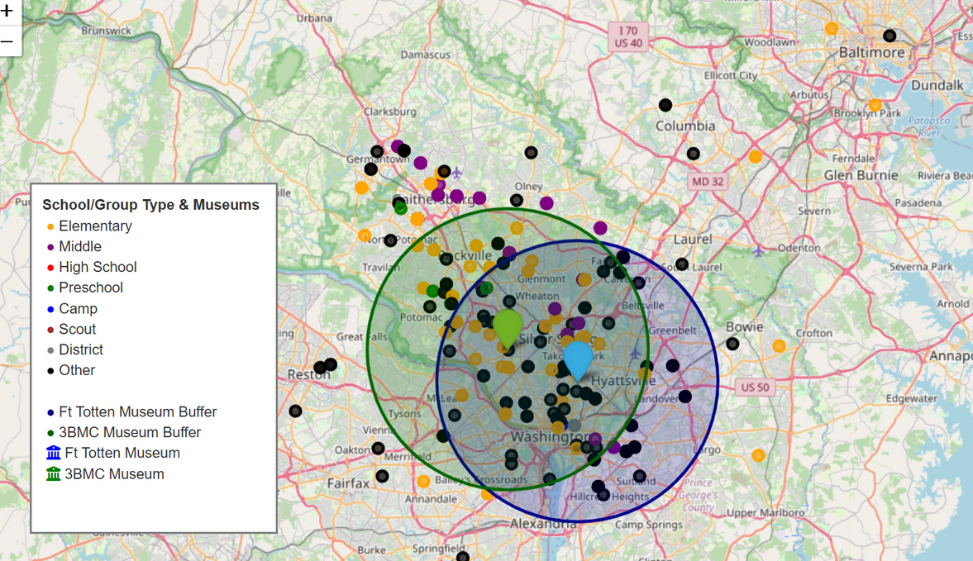
EXPLORATORY DATA ANALYSIS
Spatial Distribution of General Admission Visitors
How Distance Influences Engagement with KID Museum Programs
file:///C:/Users/piush/Downloads/KID_Museum_General_Admissions_50miles_worldwide.html

Slide 8
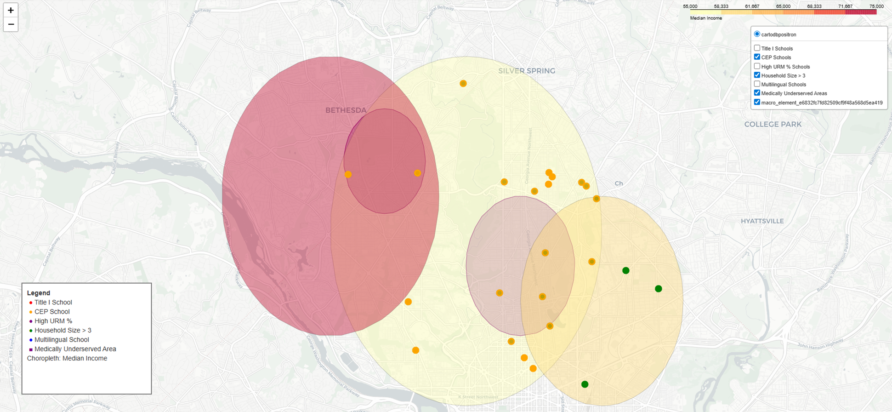
EXPLORATORY DATA ANALYSIS
Spatial Density of Field Visits Attendence and Demographic Overlays

Slide 9
NEXT STEPS....
Predictive and Statistical Modeling
Build a forecasting model to predict field-trip participation by month, grade, and district.
Analyze how distance, demographics, and seasonality influence attendance rates.
Explore regression or classification models for outreach prioritization (e.g., likelihood of return visits).
Spatial and Accessibility Analysis
Perform hotspot analysis to identify high- and low-engagement clusters.
Compare visitor density vs. underserved areas to locate equity gaps.
Evaluate potential new outreach zones beyond the current 50-mile buffers.
Dashboard and Visualization Development
Develop an interactive Power BI dashboard integrating Field Trip, After-School, and Admission data.
Publish ArcGIS Online maps and GitHub Pages links for public, shareable visuals.
Add filters for county, program type, Title I/CEP status, and time period.
Strategic Application
Use insights to inform marketing and school partnership strategies.
Recommend transportation or fee-waiver programs to increase access for distant/underserved schools.
Present final results and dashboard to KID Museum leadership and stakeholders.

Slide 10
THANK YOU
FOR YOUR ATTENTION

